Slide 1
Key Stage Three
SEROCU and SWGfL collaboration:
Computers don’t lie, but liars can compute
Terry Hayes, I Am Pilgrim

Slide 2
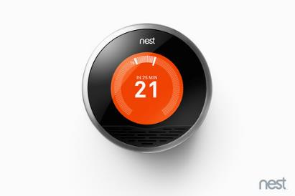
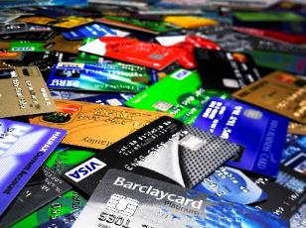
What do these have in common?
This Photo by Unknown Author is licensed under CC BY-NC-ND
This Photo by Unknown Author is licensed under CC BY-NC-ND
This Photo by Unknown Author is licensed under CC BY-SA-NC
This Photo by Unknown Author is licensed under CC BY-SA-NC
This Photo by Unknown Author is licensed under CC BY-SA
This Photo by Unknown Author is licensed under CC BY-SA

Slide 3
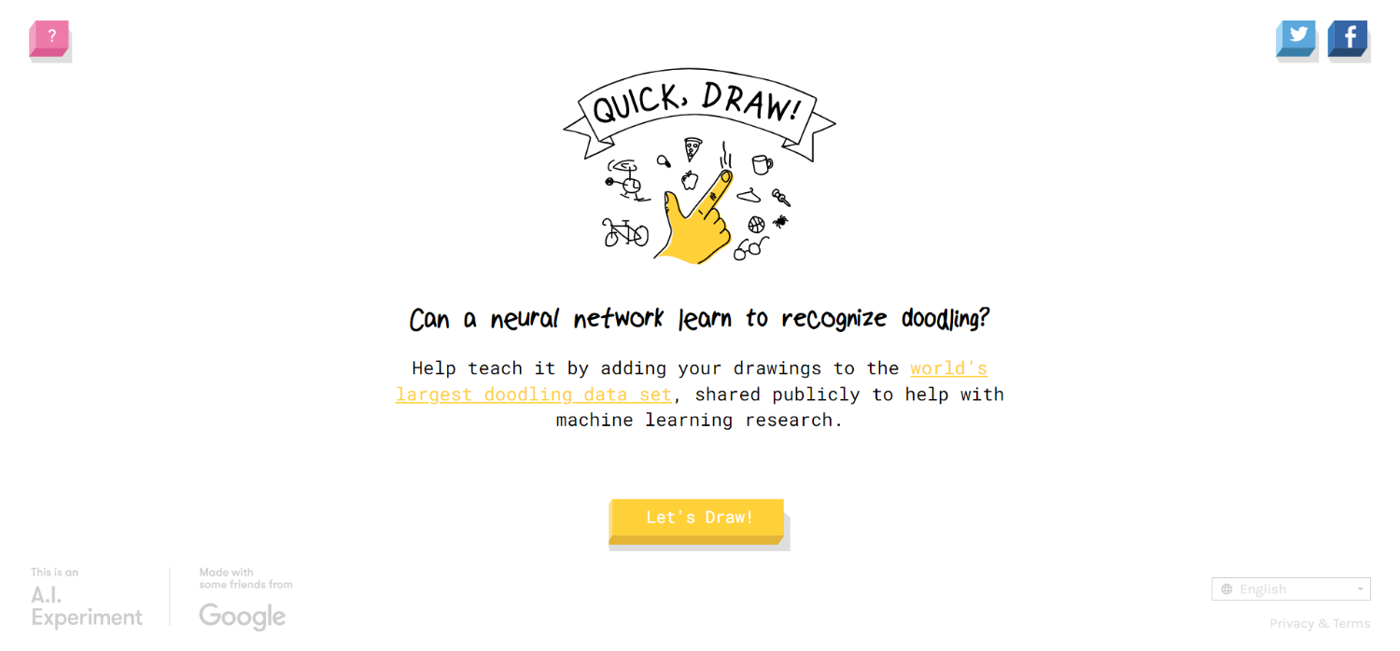
Quick, Draw!

Slide 4
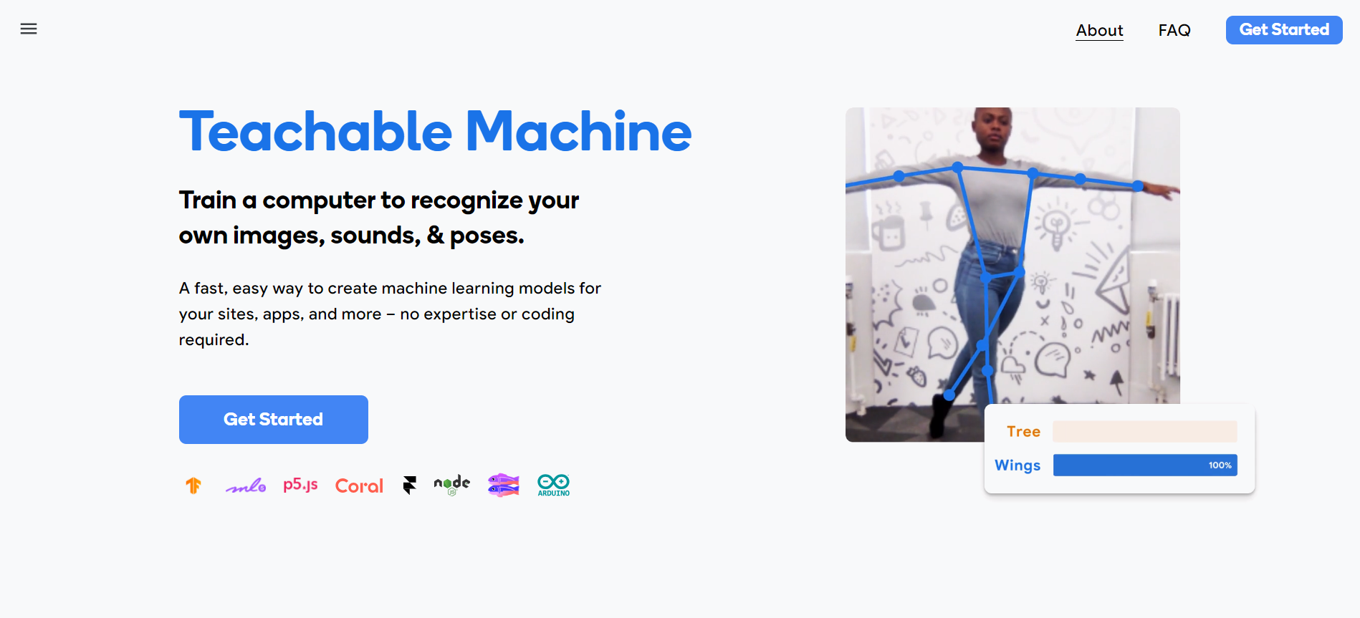

Slide 5
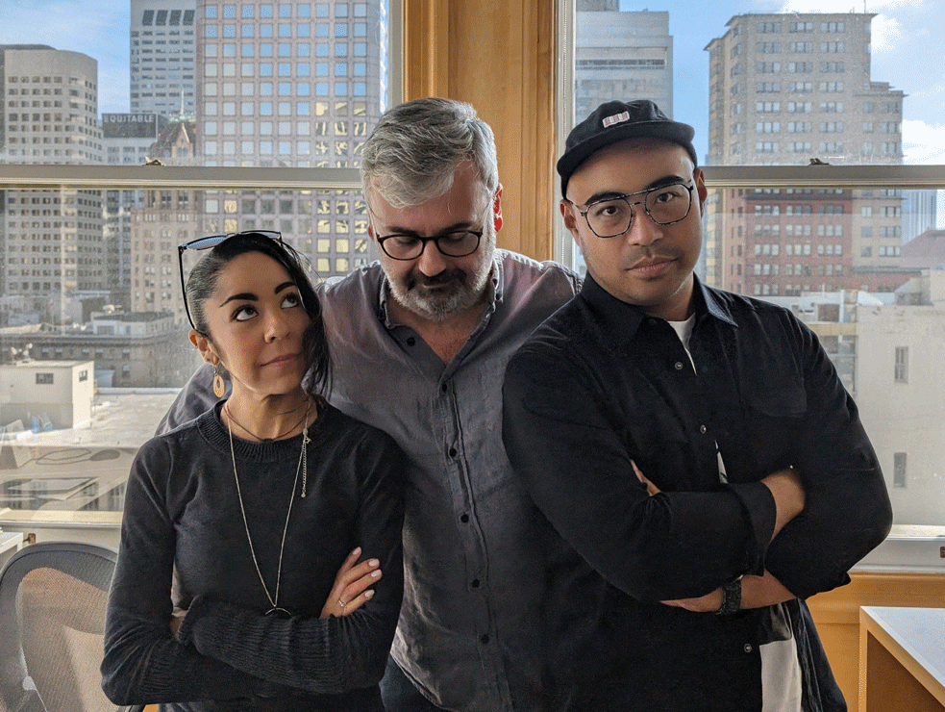
Helpful or creepy?

Slide 6
Can we trust AI outputs?
Not at all
Completely

