Slide 1
Key Stage Four
SEROCU and SWGfL collaboration:
System, creator, user

Slide 2
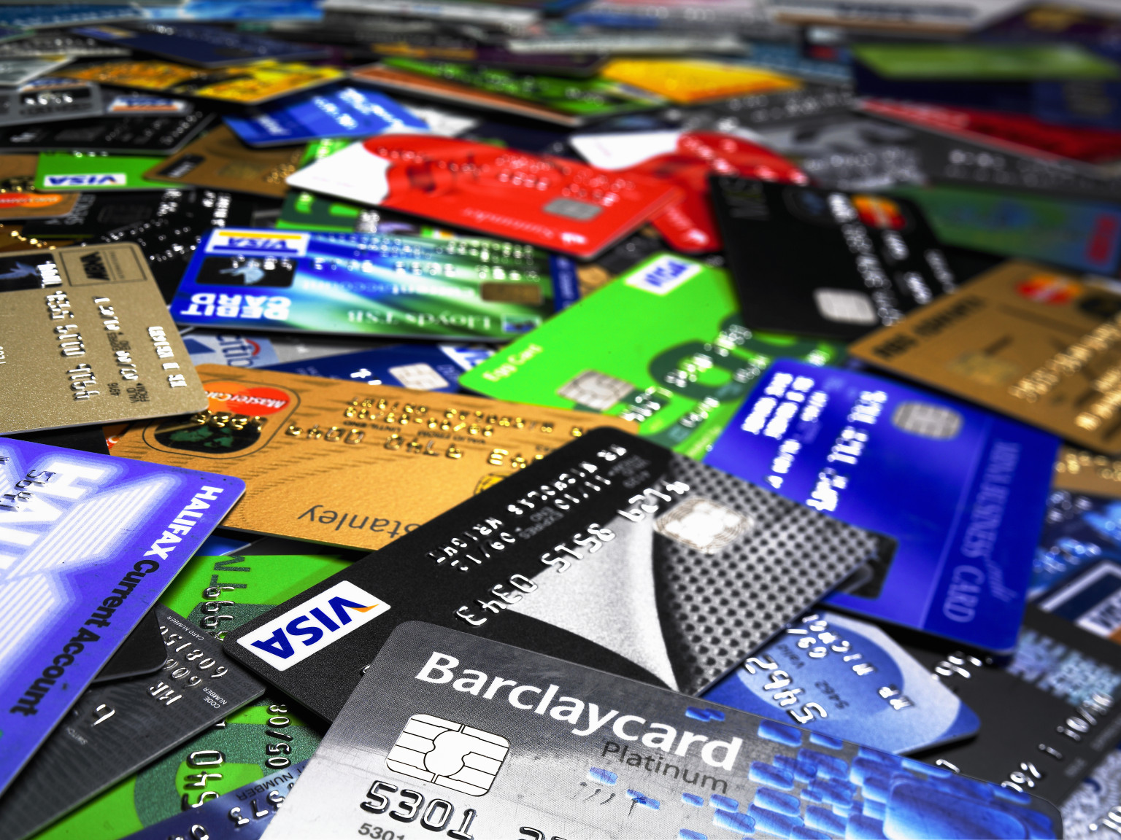
What do these have in common?
This Photo by Unknown Author is licensed under CC BY-NC-ND
This Photo by Unknown Author is licensed under CC BY-NC-ND
This Photo by Unknown Author is licensed under CC BY-SA-NC
This Photo by Unknown Author is licensed under CC BY-SA
This Photo by Unknown Author is licensed under CC BY-SA-NC
This Photo by Unknown Author is licensed under CC BY-SA

Slide 3
Data in, data out

Slide 5
Results of Applying the Policial Compass Test to Google Bard, GPT-4, ChatGPT and RightWingGPT
From the work of David Rozado

Slide 6
Motion: Who owns the output from artificial intelligence?
The creators
The system
The users

Slide 7
Forming your argument
opening statement
facts to support each point
formal language
emotive language
rhetorical questions
repetition
a counter argument
discourse markers or conjunctions to connect paragraphs
closing statement

Slide 8
Opening statements

Slide 9
Primary Arguments

Slide 10
The Floor

Slide 11
Closing Statements

Slide 12
Vote!

Slide 14
Are you detecting cancer or rulers?

